Slide 1


Introduction to Web Scraping
Part 1 – Getting Started with Web Scraping
Part 2 – Web Scraping Continued
http://research.library.gsu.edu/webdata
Jeremy Walker
Data Services Librarian
jwalker184@gsu.edu

Slide 2

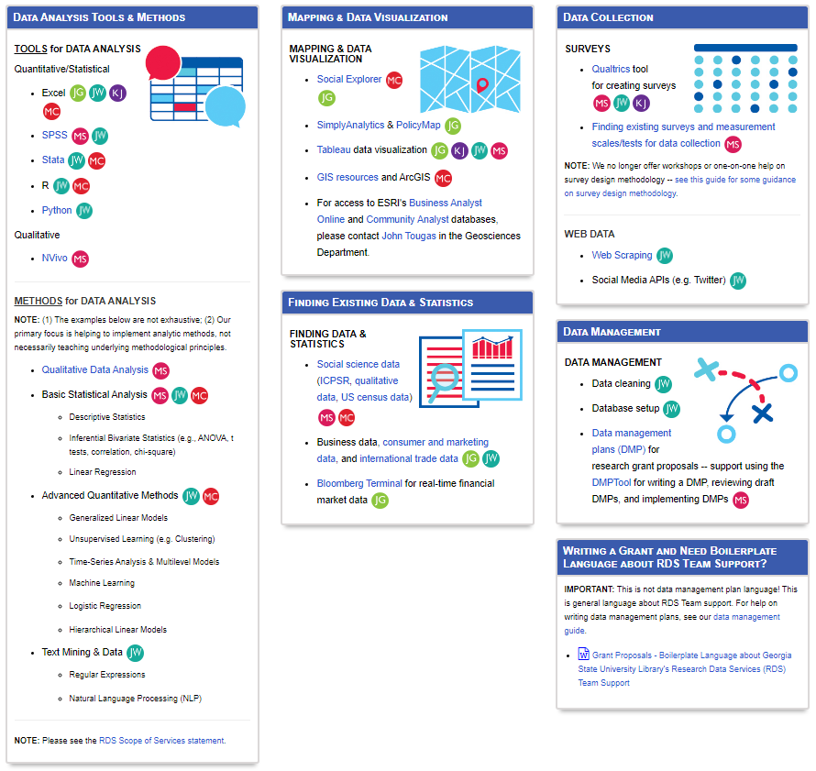
Research Data Services
RDS Team Members:
Dr. Swygart-Hobaugh: Qualitative Methods
Joel Glogowski: Data Visualization
Kelsey Jordan: Data Visualization
Jeremy Walker: Quantitative Methods
M. Emre Coskun: Quantitative Methods
General Information, workshops, contact info:
https://research.library.gsu.edu/dataservices

Slide 3

Data Certification
Attend 5 different workshops this semester
Earn a data certification through Research Data Services
https://research.library.gsu.edu/dataservices/data-certified

Slide 4
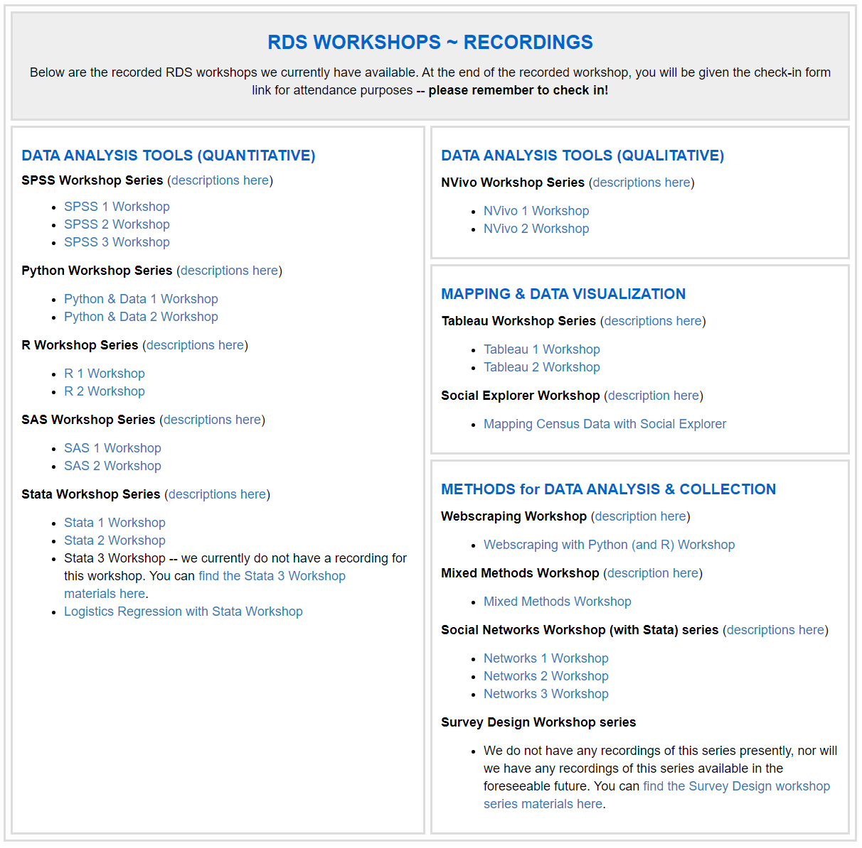
Other RDS Workshops
The Research Data Services team hosts a variety of workshops for different software tools and packages.
At the moment, we are also uploading recorded versions of our workshops to our website for anyone to access.
Workshop Schedule
https://research.library.gsu.edu/dataservices
Recorded Workshops
https://research.library.gsu.edu/dataservices/rds-workshops-recordings
Data Certification
https://research.library.gsu.edu/dataservices/data-certified

Slide 5
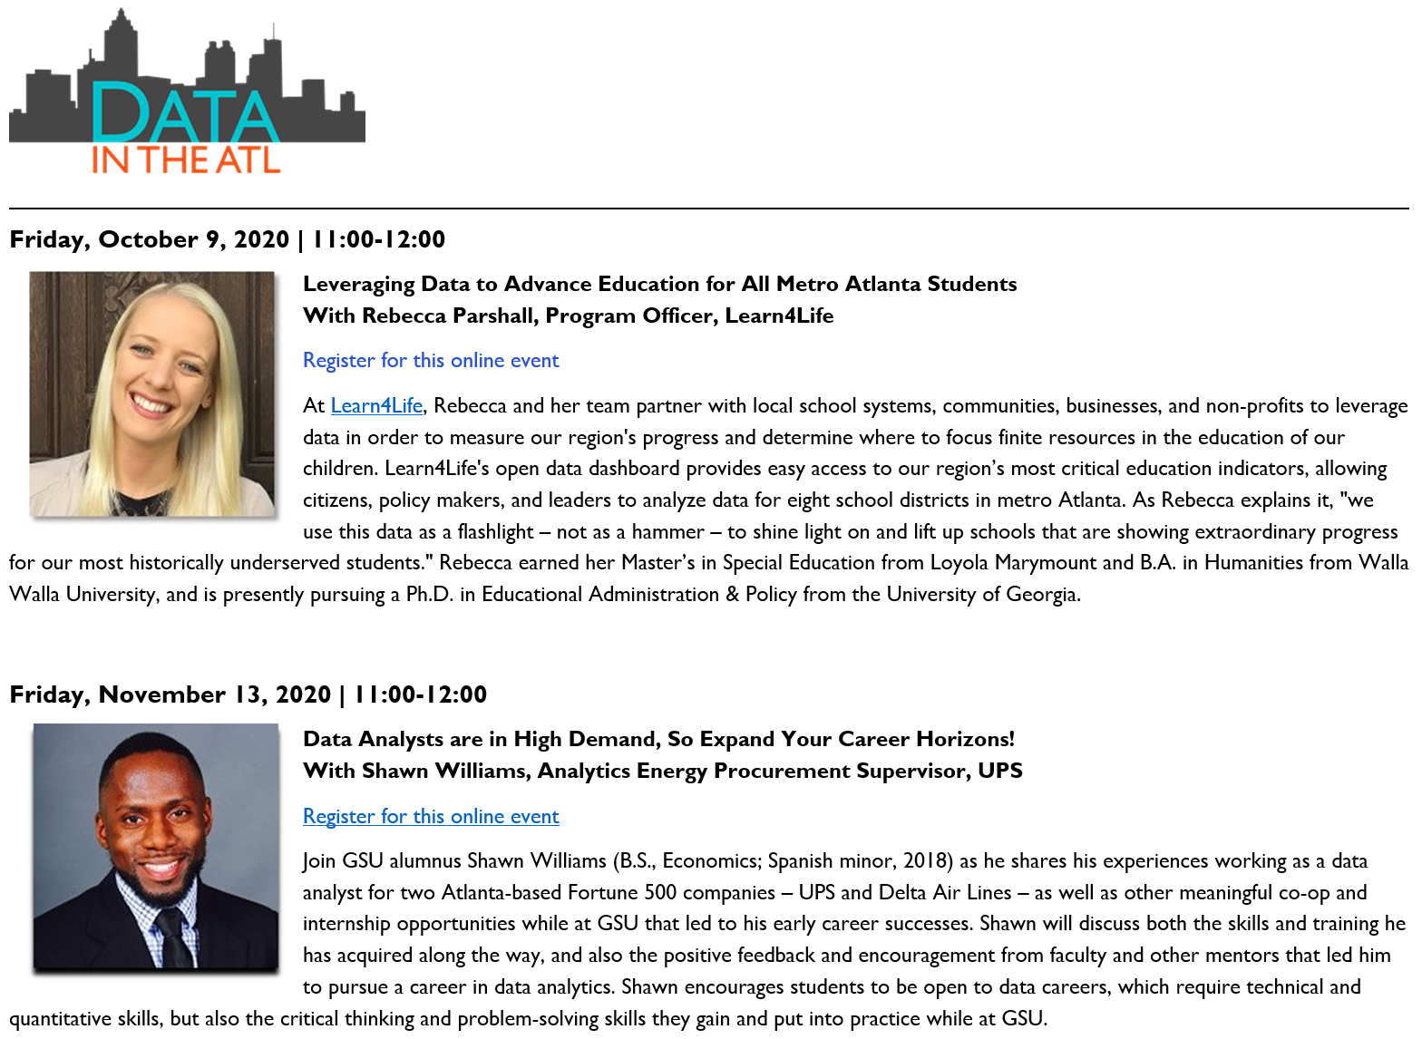
DATA IN THE ATL – SPEAKER SERIES
#DataInTheATL is a speaker series hosted by Georgia State University Library that connects the university with a variety of Atlanta-based professionals, highlighting how data analysis is being used successfully in their daily work while introducing students to potential careers in data science.
Webpage / Info / Registration
https://research.library.gsu.edu/c.php?g=755604&p=5415549

Slide 6
Preamble, Prerequisites, and Recommendations
This workshop may be CHALLENGING.
I strongly recommend completing the Python or R workshop series if you are brand new to coding.
RDS Python series - https://research.library.gsu.edu/python
RDS R series - https://research.library.gsu.edu/r
DO NOT BE DISCOURAGED – Even if this workshop feels overwhelming and you’re not quite ready, please stay anyway! Listen, watch, ask questions, and participate in chat!

Slide 7



Software for this workshop….
Anaconda + Jupyter Notebooks
Download: https://www.anaconda.com/products/individual
Google Chrome
Download: https://www.google.com/chrome/
Set as default: https://support.google.com/chrome/answer/95417?co=GENIE.Platform%3DDesktop&hl=en

Slide 8
Session Agenda
Part 1 – Getting Started with Web Scraping
Overview of web-scraping:
Use-cases and examples
Ethics and legal concerns
Intro to basic web scraping tools & techniques:
Using Python, Anaconda, and Jupyter Lab (or Notebook)
Accessing websites programmatically
Parsing and navigating through HTML code
Saving webpages locally
Part 2 – Web Scraping Continued
Sample project
Creating basic functions and loops
Guided walkthrough of simple web-scraping project
Beyond the basics
URL parameters
Selenium demonstration

Slide 9
Session Agenda
WE ARE NOT COVERING…
Social Media APIs:
Twitter, Facebook, Instagram, etc…
Point-and-click tools
Parse Hub, Octoparse, etc…
R Code
There is parallel R code included in the workshop materials, but all instruction will be done using Python, Jupyter Notebooks, and Anaconda.
The R code follows the same general outline and structure, but you will need to access it and use it on your own.

Slide 10
Web Scraping in Context
Web Scrapers
Web Crawlers
Automated Testing
Smaller programs designed to target and collect information from a narrowly defined scope of webpages. Usually used for academic and market research.
These are more generalized than web-scraping programs and are usually designed to index a large number of webpages and websites. Most high-profile examples are search engines (Google Search, Bing, Baidu, etc…)
Web developers will use scripts and programs to automatically and systematically test extremely large websites. The tools used for automated testing are sometimes the exact same tools as those used for web scraping.

Slide 11
Web Scraping in the Research Process
Research Design
Data Collection
Data Analysis
Hypothesizing, identifying data sources, surveying literature, etc…
Distributing surveys, monitoring instruments, working with databases, cleaning data, etc…
Qualitative coding, statistical analyses, hypothesis testing, etc…

Slide 12
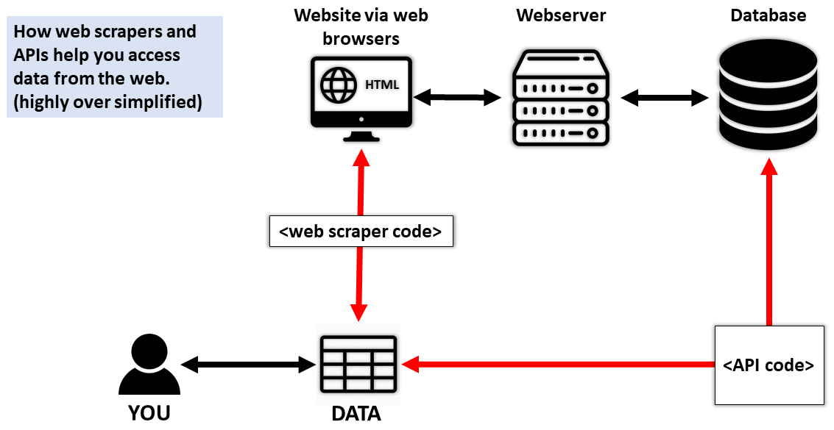
Web Scraping vs APIs

Slide 13
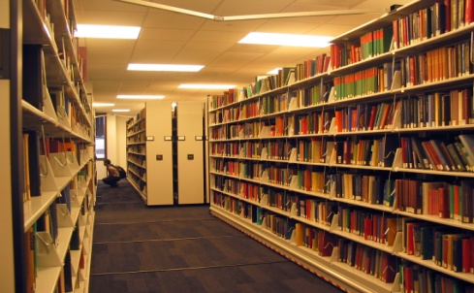
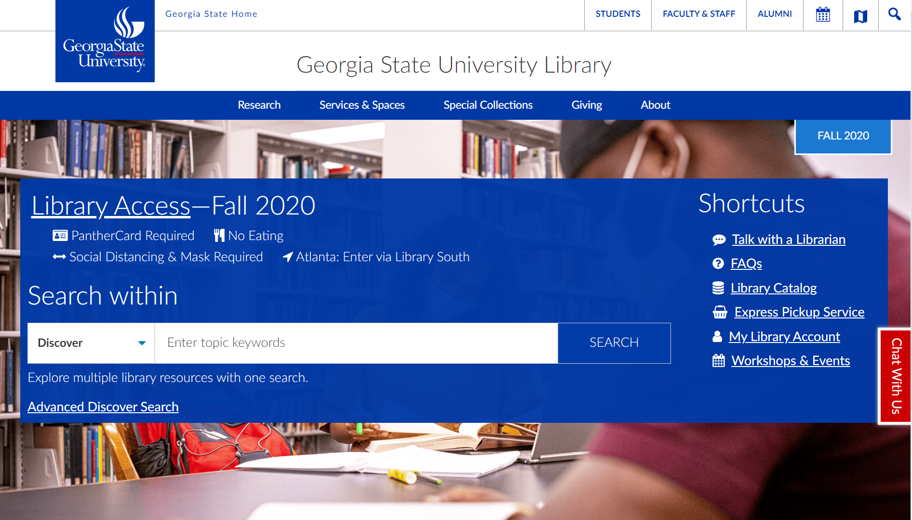
Web Scraping vs APIs
(as a metaphor)
What books are in the GSU Library?

Slide 14
Web Scraping vs APIs
(as a metaphor)
What books are in the GSU Library?
You could walk through the library and write down each title manually…
…or you could just use the library catalog.

Slide 15
Web Scraping vs APIs
(as a metaphor)
What books are in the GSU Library?
You could walk through the library and write down each title manually…
…or you could just use the library catalog.
web scraping
API

Slide 16
Web Scraping vs APIs
When available, it is almost always better to use an API instead of web-scraping for the purposes of data collection.
web scraping
API

Slide 17
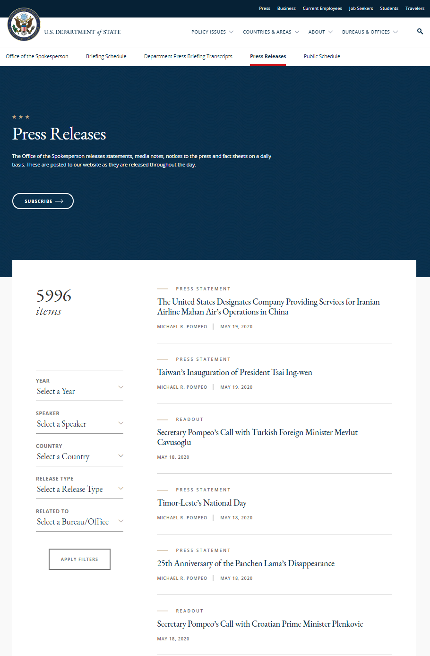

Web Scraping – Sample Use Cases
Collecting organized information
Data or document storage
Some examples include…
Blogs
Lists
Search results
FAQs
New Bulletins
Profiles
Product Pages
www.state.gov/press-releases/

Slide 18
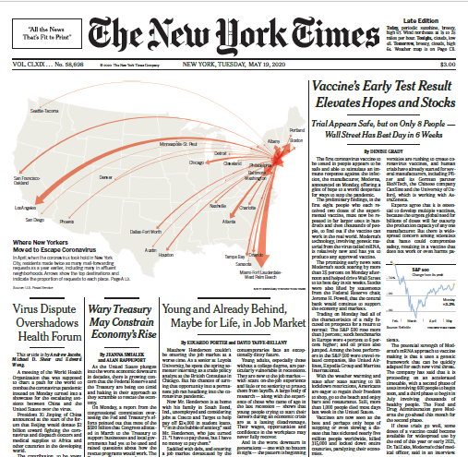
Web Scraping – Sample Use Cases
Mon
Tue
Wed
Thu
Fri
Sat
Sun
Data or document storage
Performing routine and tedious data collection.
Systematically collecting webpages from many different websites
Repeatedly collecting webpages on a set schedule (daily, weekly, etc…)
www.nytimes.com

Slide 19

Is web scraping legal or ethical?
Is it legal?
Is it ethical?
“NO”
“YES”
There are no clear-cut answers unfortunately. There are a myriad of variables and considerations that you will need to address for your specific research project.

Slide 20
Is web scraping legal or ethical?
Is it legal?
Copyright
Terms of Use / User-Agreements
Computer Fraud and Abuse Act
“NO”
Is it ethical?
“YES”
Personal / identifiable data
Sustainability

Slide 21
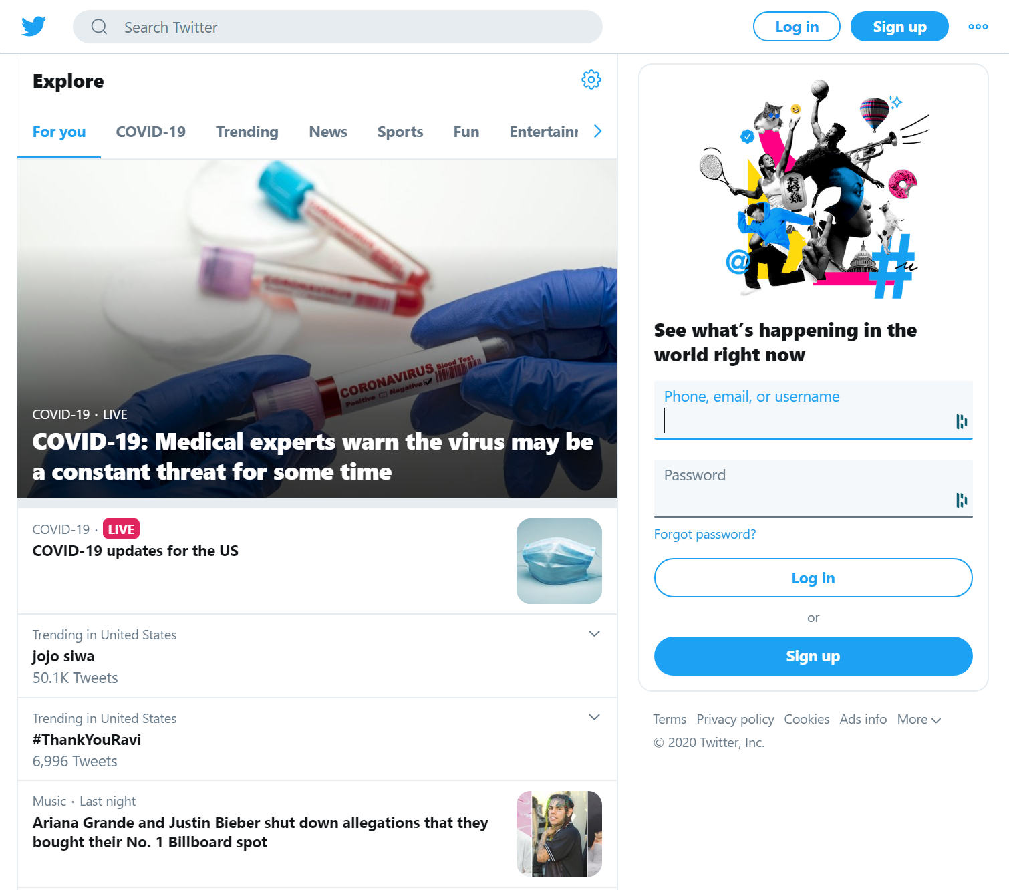
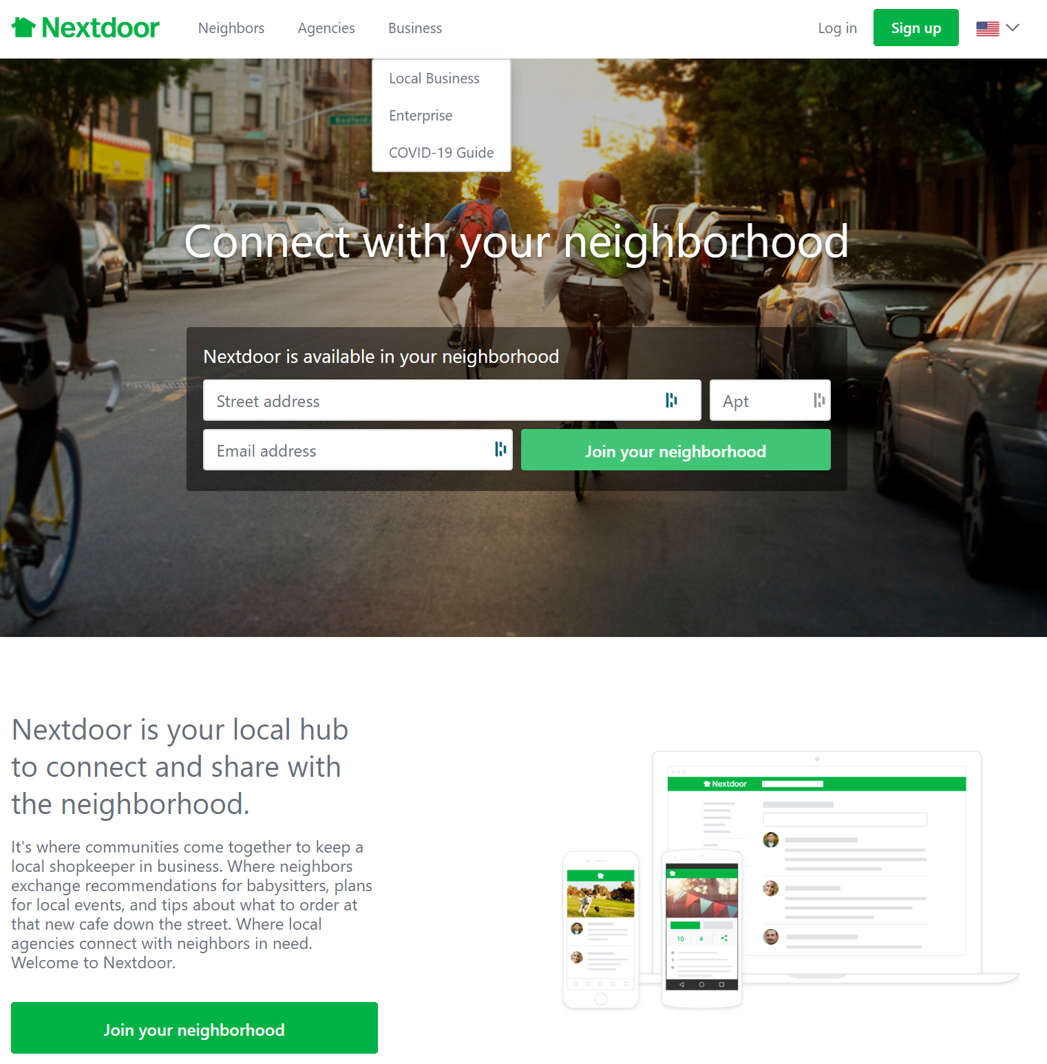





Examples of Legal and Ethical Issues
Twitter
Library Databases
Nextdoor

Slide 22
Examples of Legal and Ethical Issues
In short, you should not use a web scraper on these websites.
Twitter
Library Databases
Nextdoor
Twitter offers an official API explicitly for the purposes of collecting and analyzing their data. APIs are usually a more sustainable method of gathering data.
Library databases (and many journals) have very clear and strongly enforced Terms of Service that contractually prohibit users from web-scraping activities.
Nextdoor users have a reasonable expectation that their online behavior is not publicly available.

Slide 23
Where to get legal and ethical guidance
GSU Institutional Review Board (IRB)
https://ursa.research.gsu.edu/human-subjects/
GSU Office of Legal Affairs
https://universityattorney.gsu.edu/
YOUR boss, department chair, advisor, supervisor, etc…
NOT your boss
NOT a lawyer
NOT your IRB expert

Slide 24
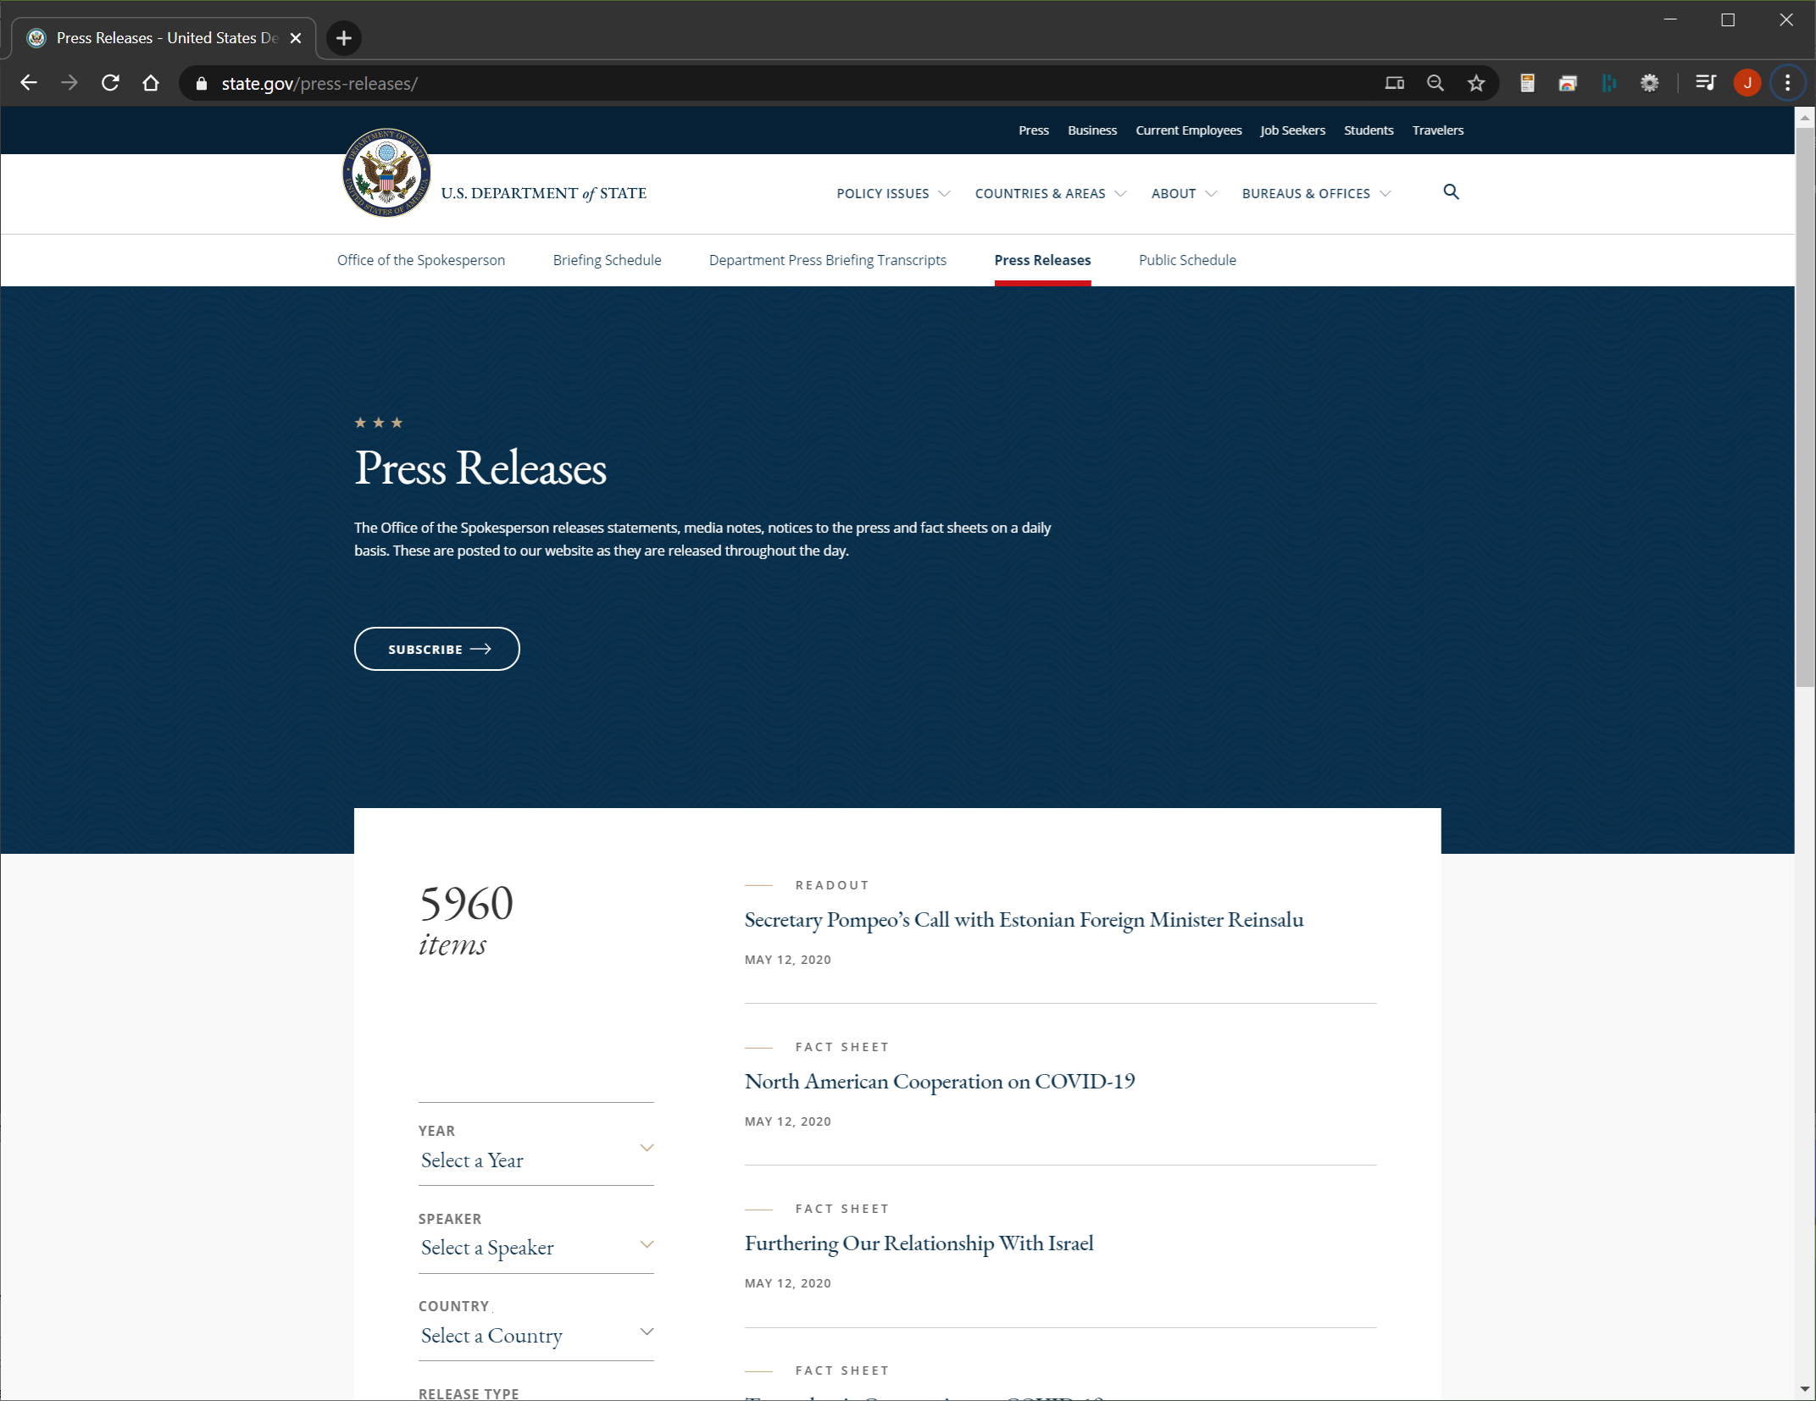
Practice using US State Department
https://www.state.gov/press-releases/
Press Releases
Public documents
Blog-style structure
Lots of qualitative/text data

Slide 25
Practice using US State Department
Let’s pretend that we want to use State Department documents as the basis for a content-analysis or text-mining project…
Today’s Objective
Use Python to go to the State Department’s website
Programmatically open and save individual webpages

Slide 26
Workshop Files
https://research.library.gsu.edu/webdata
Please download the ZIP file and “extract” the files to your computer.

Slide 27
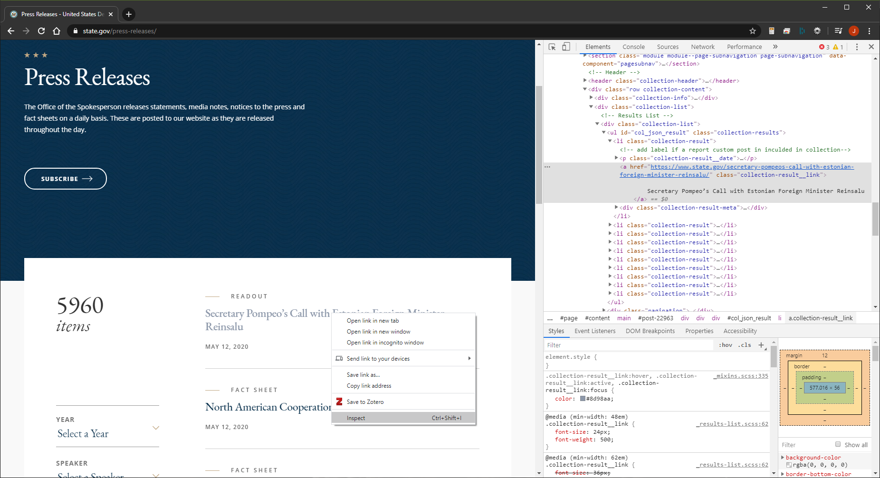
Inspecting HTML
What we “see”.
What the computer can “see”

Slide 28
Inspecting HTML
In most browsers, there is some way to “inspect” or “view source” the underlying HTML code for any given website.
Using Google Chrome on Windows, right-click on any any element of a webpage and select “inspect” to begin viewing webpage code.
Note: The exact process may be different with different browsers and OS platforms.

Slide 29
Inspecting HTML
What the computer can “see”
This view contains the info necessary to begin web scraping
HTML, CSS, Javascript
Text, links, metadata
All information is organized in the DOM (“document object model”). The DOM is structured into a nested hierarchy that forms a tree-like structure.

Slide 30
Webpage Structure
What the computer can “see”
HTML Structure (simplified)
html
div
div
li
li
li
nav
li
li
li
h1
p

Slide 31
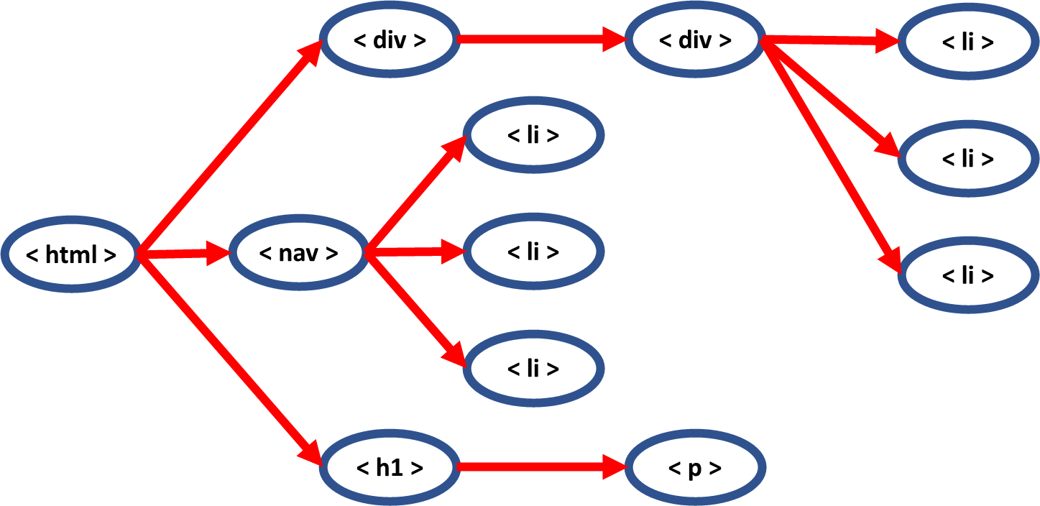
Webpage Structure
HTML Structure (simplified)
html …
div …
div …
li …
li …
li …
nav …
li …
li …
li …
h1 …
p …

Slide 32
Navigating Through Elements
Using BeautifulSoup4
soup.find( “ nav ” )
< div >
< div >
< li >
< li >
< li >
< html >
< nav >
< li >
< li >
< li >
< h1 >
< p >

Slide 33
Navigating Through Elements
Using BeautifulSoup4
soup.find( “ h1 ” )
< div >
< div >
< li >
< li >
< li >
< html >
< nav >
< li >
< li >
< li >
< h1 >
< p >

Slide 34
Navigating Through Elements
Using BeautifulSoup4
soup.find( “ li ” )
< div >
< div >
< li >
< li >
< li >
< html >
< nav >
< li >
< li >
< li >
< h1 >
< p >

Slide 35
Navigating Through Elements
Using BeautifulSoup4
soup.find_all( “ li ” )
< div >
< div >
< li >
< li >
< li >
< html >
< nav >
< li >
< li >
< li >
< h1 >
< p >

Slide 36
Navigating Through Elements
Using BeautifulSoup4
soup.find( “ li ” ).find_next( “ li “ )
< div >
< div >
< li >
< li >
< li >
< html >
< nav >
< li >
< li >
< li >
< h1 >
< p >

Slide 37
Navigating Through Elements
Using BeautifulSoup4
soup.find( “ nav ” ).find_all( “ li “ )
< div >
< div >
< li >
< li >
< li >
< html >
< nav >
< li >
< li >
< li >
< h1 >
< p >

Slide 38
Navigating Through Elements
Using BeautifulSoup4
soup.find( “ nav ” ).find ( “ li “ ).text
< div >
< div >
< li >
< li >
………
< li >
< html >
< nav >
< li >
< li >
< li >
< h1 >
< p >

Slide 39
Navigating Through Elements
Using BeautifulSoup4
soup.find( class_ = “xxx” ).find_all( “ li “ )
< div >
< div class=“xxx”>
< li >
< li >
< li >
< html >
< nav >
< li >
< li >
< li >
< h1 >
< p >

Slide 40
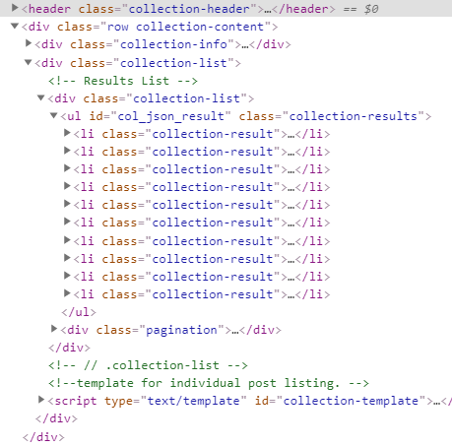
Navigating Through Elements
Using BeautifulSoup4

Slide 41
Navigating Through Elements
Using BeautifulSoup4
soup.find( class_ = “collection-content” )

Slide 42
Navigating Through Elements
Using BeautifulSoup4

Slide 43
Navigating Through Elements
Using BeautifulSoup4
soup.find( class_ = “collection-results” ).find_all(“li”)
soup.find( “ul” ).find_all(“li”)

Slide 44
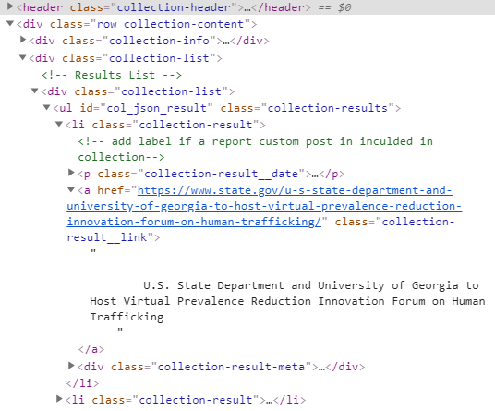
Navigating Through Elements
soup.find( class_ = “collection-results” ).find(“li”).find(“a”)

Slide 45
Navigating Through Elements
soup.find( class_ = “collection-results” ).find(“li”).find(“a”)

Slide 46
Navigating Through Elements
soup.find( class_ = “collection-results” ).find(“li”).find(“a”)

Slide 47
Navigating Through Elements
soup.find( class_ = “collection-results” ).find(“li”).find(“a”)

Slide 48
Navigating Through Elements
soup.find( class_ = “collection-results” ).find(“li”).find(“a”).text
“U.S. State Department and University of Georgia to Host Virtual Prevalence Reduction Innovation Forum on Human Trafficking”
soup.find( class_ = “collection-results” ).find(“li”).find(“a”)[“href”]
https://www.state.gov/u-s-state-department-and-university-of-georgia-to-host-virtual-prevalence-reduction-innovation-forum-on-human-trafficking/

Slide 49
Loops and Functions
Portions of the workshop code heavily rely on an understanding of “loops” and “functions” in the context of either Python or R. Below are some links to generic resources and tutorials that you may find helpful.
PYTHON
R
Loops
https://www.w3schools.com/python/python_for_loops.asp
https://www.tutorialspoint.com/python/python_for_loop.htm
Function
https://www.w3schools.com/python/python_functions.asp
https://www.tutorialspoint.com/python/python_functions.htm
Loops
https://www.tutorialspoint.com/r/r_for_loop.htm
https://www.r-bloggers.com/how-to-write-the-first-for-loop-in-r/
Functions
https://www.tutorialspoint.com/r/r_functions.htm
https://www.statmethods.net/management/userfunctions.html

Slide 50
More Advanced Tools…
SELENIUM WEBDRIVER (Python)
Selenium is a tool for using Python (and other programming languages) to automatically control a “headless” or “developer” version of a web browser. In essence, you can write code and instructions in Python, and then those instructions will be carried out using a browser like Google Chrome or Mozilla Firefox.
Official Guide & Docs: https://selenium-python.readthedocs.io/navigating.html
Two Unofficial Guides (many more exist though)
https://towardsdatascience.com/web-scraping-using-selenium-python-8a60f4cf40ab
https://www.scrapingbee.com/blog/selenium-python/
CRITICAL next steps to consider
Not all websites have “static” content. Websites that make heavy use of Javascript, interactive elements, other dynamic content may require more powerful web-scraping tools.

Slide 51
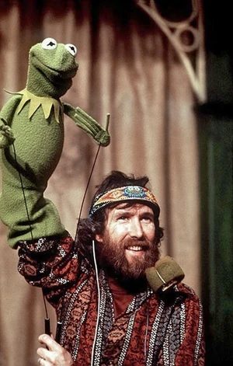


Selenium
Python controls Selenium
Selenium controls Chrome
Chrome interacts with webpages
https://muppet.fandom.com/wiki/Jim_Henson

Slide 52
More Resources
GSU Library – Research Data Services https://research.library.gsu.edu/dataservices
GSU LinkedIn Learning – General purpose programming courses https://technology.gsu.edu/technology-services/it-services/training-and-learning-resources/linkedin-learning/
GSU O’Reilly for Higher Education – Amazing ebook repository full of technical training books https://research.library.gsu.edu/az.php?a=o&q=Higher%20Education
Assorted Python Guides
Python Requests Module - https://requests.readthedocs.io/en/master/
BeautifulSoup - https://www.crummy.com/software/BeautifulSoup/bs4/doc/
Assorted R Guides
Rvest - https://blog.rstudio.com/2014/11/24/rvest-easy-web-scraping-with-r/
Rvest Tutorial - https://www.r-bloggers.com/practical-introduction-to-web-scraping-in-r/
Selenium & Headless Browsing
R - https://cran.r-project.org/web/packages/RSelenium/vignettes/headless.html
Selenium / Python - https://selenium-python.readthedocs.io/
Google it!
Seriously, there are TONS of great tutorials, walkthroughs, and guides in the wild world of the internet.
YouTube often has a mix of both high-level and niche tutorials.
Stack Overflow is a community-driven forum where you can find extremely specific examples and guidance.

Slide 53
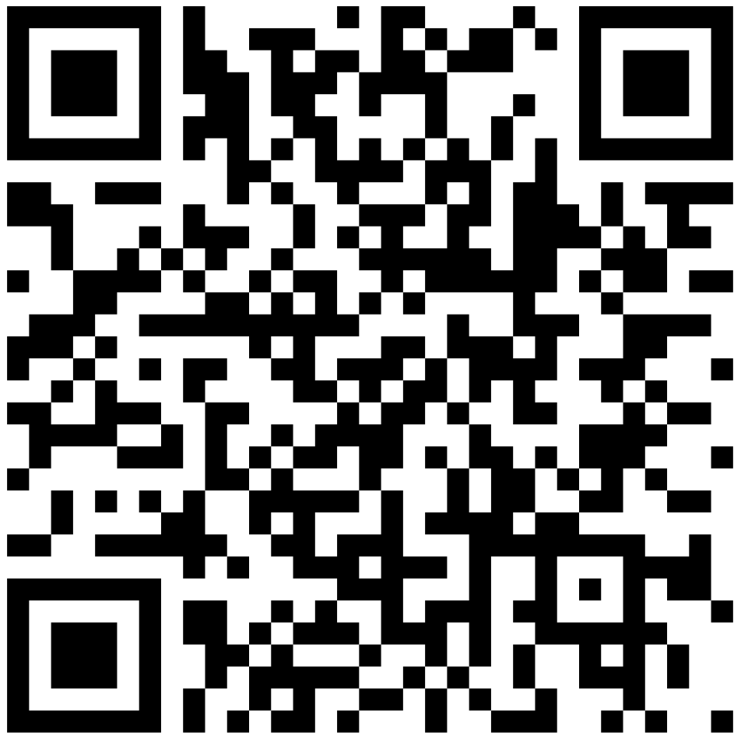
Workshop Registration & Attendance
Please check-in and provide feedback!
We really value any feedback you are able to share with us.
RDS@GSU Data Certificate seekers:
It is your responsibility to check-in via this form because it is the only way that we are tracking workshop attendance for the RDS@GSU Data Certificate requirements.
https://bit.ly/rds-check-in

